Slide 1

Seidu Suleiman
Data Analytics Intern at Oasis Infobyte

Slide 2
Exploratory Data Analysis of Retail Sales Data
Task 1.2
Insights and Recommendations for Business Optimization

Slide 3
Introduction
Objective:
To analyze retail sales data to uncover patterns and provide actionable insights.
Key Focus Areas:
Data Cleaning and Exploration
Descriptive Statistics
Visual Trends and Patterns
Recommendations for Business Improvement

Slide 4
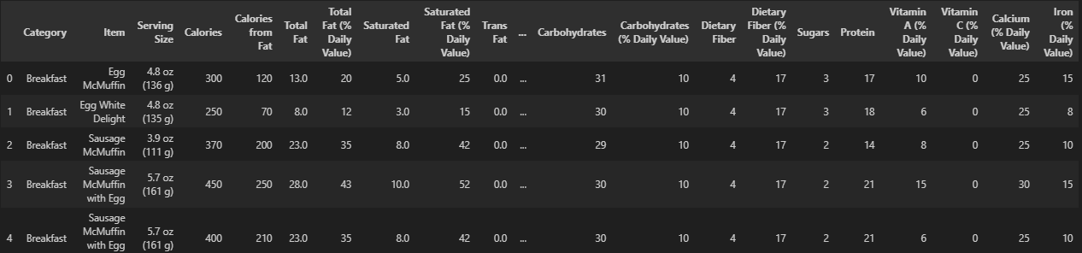
Dataset Overview
Dataset Details:
Number of rows and columns.
Key columns: Category, Item, Calories, Total Fat, Sodium, etc.

Slide 5

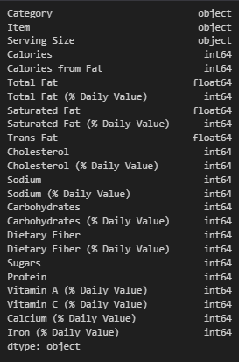
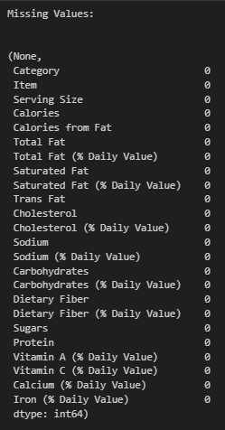
Data Cleaning
Actions Taken:
Checked for missing values: None found.
Removed duplicates: None found.
Verified column data types: All correct.

Slide 6
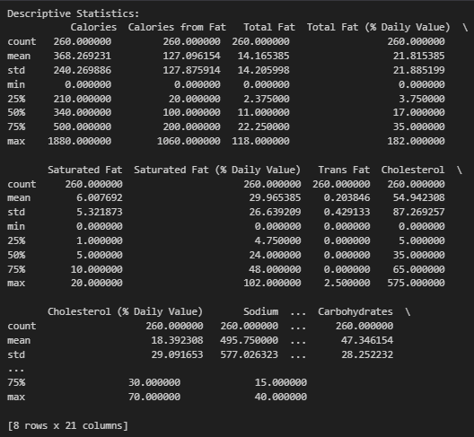
Descriptive Statistics
Summary Statistics:
Average Calories: 368.27
Sodium Range: 0 to 3600 mg
Dietary Fiber Average: 1.63 g

Slide 7
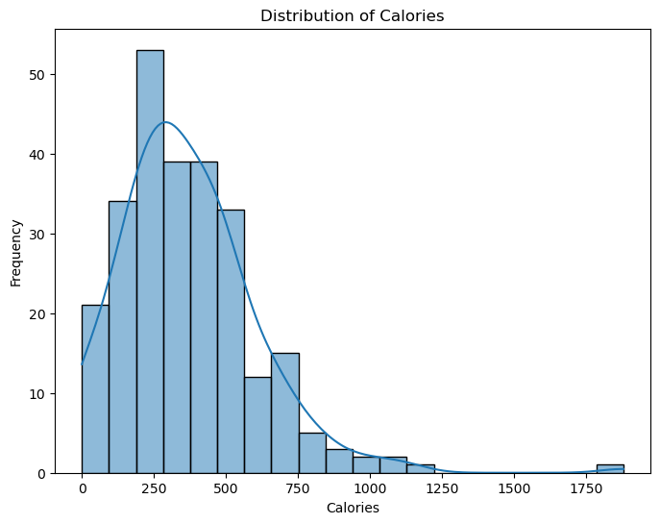
Visualizations – Calorie Distribution
Histogram to show calorie distribution.
Key Insight: Highlight the range of high-calorie items and their prevalence.

Slide 8
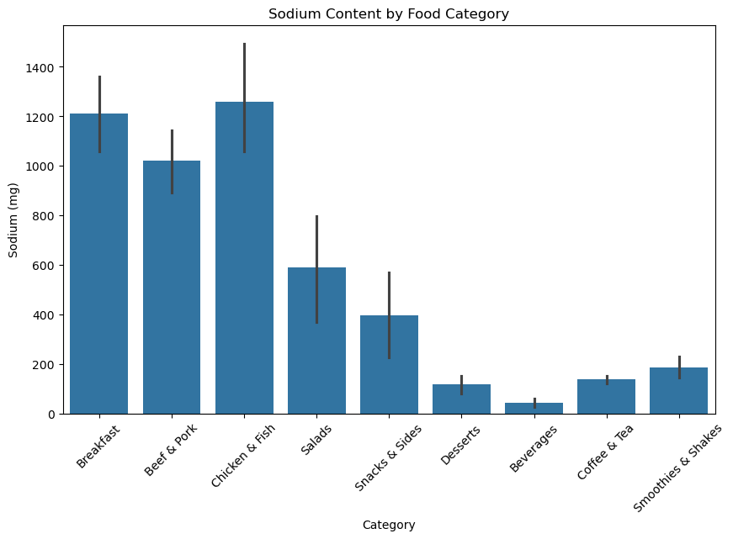
Visualizations – Sodium Content
Bar chart comparing sodium levels across categories.
Key Insight: Identify categories with the highest sodium levels.

Slide 9
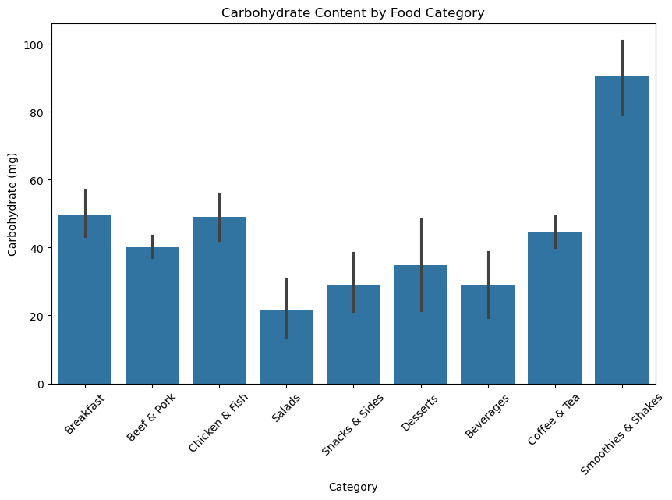
Visualizations – Carbohydrate Content
Bar chart comparing carbohydrate levels across categories.
Key Insight: Identify categories with the highest carbohydrate levels.

Slide 10
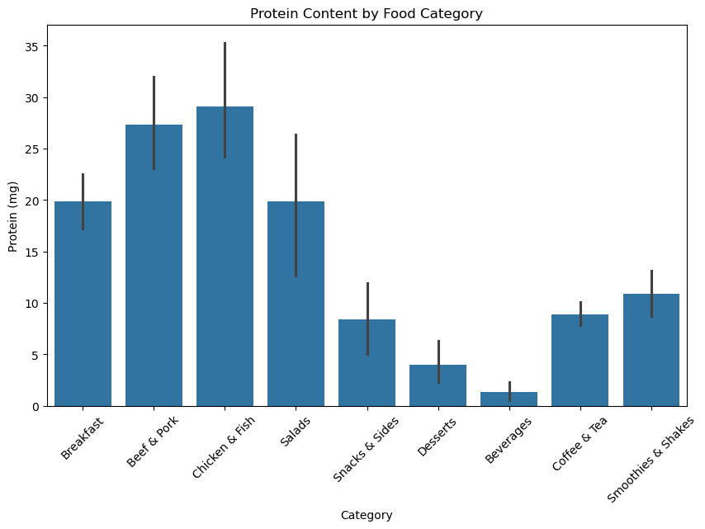
Visualizations – Protein Content
Bar chart comparing protein levels across categories.
Key Insight: Identify categories with the highest protein levels.

Slide 11
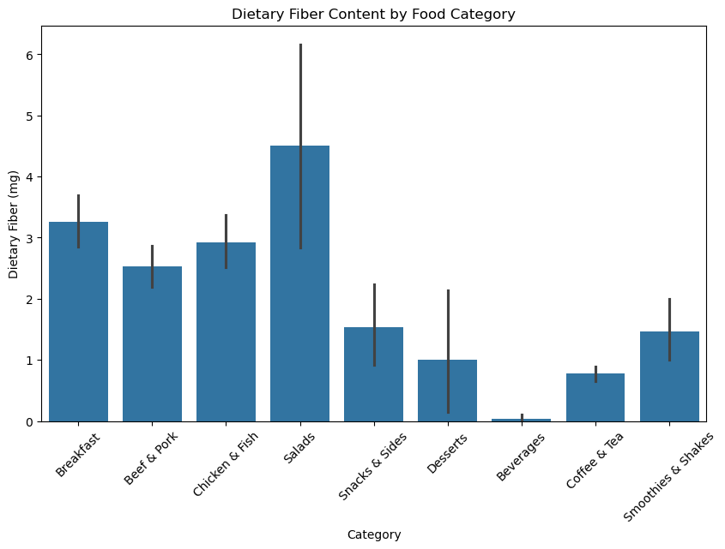
Visualizations – Dietary Fiber Content
Bar chart comparing dietary fiber levels across categories.
Key Insight: Identify categories with the highest dietary fiber levels.

Slide 12
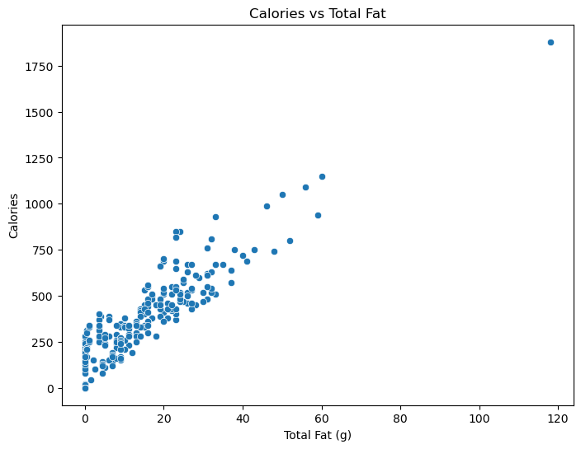
Visualizations – Total Fat vs Calories
Scatter plot showing correlation between total fat and calories.
Key Insight: High-fat items correlate with high-calorie counts.

Slide 13
Insights Summary
Key Findings:
Wide variation in calorie and sodium content.
Low dietary fiber across most menu items.
Certain categories contribute significantly to high sodium and calorie intake.

Slide 14
Recommendations
Health-Conscious Menu Options: Add low-calorie and low-sodium items.
Portion Control: Offer smaller serving sizes for high-calorie items.
Fiber-Rich Options: Introduce items with more dietary fiber.
Sodium Reduction: Reformulate high-sodium recipes.
Customer Communication: Use clear nutritional labels and provide a nutrition calculator.

Slide 15
Action Plan
Short-Term Actions:
Reformulate high-sodium and high-calorie items.
Highlight existing healthier options.
Long-Term Actions:
Develop new healthy menu sections.
Target specific customer demographics with marketing campaigns.

Slide 16
Conclusion
Summary:
Some items have extremely high calorie, fat, and sodium content.
The average dietary fiber content is low (1.63 g), with most items contributing less than the recommended daily intake.
Actionable recommendations for growth:
Include more fiber-rich in the menu and reformulate recipes with high calorie, fat and sodium items to reduce these contents.
Final Note:
Implementing these strategies can improve profitability and customer satisfaction.

Slide 17
Thank
You!

Slide 18

Let me know!
Email
seidusuleiman0@gmail.com
Linkedin
https://www.linkedin.com/in/suleiman-seidu-8b2135343

